Slide 1
Expense Tracker
A Web-Based Manual Expense Tracker
Presenters:
Pranavi Uprety
Anuska Khatri
Niharika Rajbhandari
Under Supervision of
Sanju Shrestha

Slide 2
Outline
Title
Introduction
Motivation
Problem Statement
Literature Review
Objectives
Key Features
Methodology
Tech Stack
Feasibility
Gantt Chart
Team Roles

Slide 3
Introduction
Web-based expense tracking application
Fully manual entry
Designed for students and employees
Supports personal and shared expenses
Focus on simplicity and privacy

Slide 4
Motivation
Students face difficulty tracking daily expenses
Shared expenses with friends often create confusion
Most apps are complex or paid
Limited reliable solutions in Nepal
Need for simple, free, and local-friendly tool
Promotes better financial habits

Slide 5
Problem Statement
Manual tracking in Excel is time-consuming
Difficulty in settling group expenses
No proper budgeting visualization
Privacy concerns with auto-sync apps
Existing free tools have heavy limitations

Slide 6
Literature Review
Splitwise: Strong in group splitting, weak budgeting
Goodbudget: Excellent envelopes, limited free version
Spendee: Good visuals, restricted free tier
Gap: Balanced manual tool with group features
Opportunity for simple & effective solution

Slide 7
Comparison
Existing System
Complex Interface
Some features are paid
Heavy bank dependency
Limited group budgeting
Generic financial tools
Limited customization
Advanced apps may confuse users
Our System
Simple interface
Free core features
Manual tracking supported
Group expense splitting
Student-friendly design
Flexible budget categories
Easy and user-friendly

Slide 8
Objectives
Develop a responsive web expense tracker
Enable manual income and expense tracking
Implement budget setting and alerts
Provide group expense splitting feature
Deliver clear reports and visualizations
Ensure data privacy and user-friendliness

Slide 9
Key Features
User registration and login
Multiple wallets and categories
Add income & expense transactions
Budgets with progress tracking
Group expense splitting & settlement
Dashboard, reports, and charts
Savings goals and bill reminders
Email Reminders and Notification

Slide 10
Methodology
Followed Agile development approach
Phases: Planning → Design → Implementation → Testing
User-centered design process
Iterative development and testing
Focus on clean code and documentation

Slide 11
Tech Stack
HTML – structure
CSS – design
JavaScript – functionality
Backend – Node.js / PHP
Database – MySQL / MongoDB

Slide 12
Feasibility
1. Technical Feasibility
Built using standard web technologies (HTML, CSS, JavaScript, PHP/Node.js)
Easy to develop, deploy, and maintain
Compatible with most devices and browsers
2. Operational Feasibility
Simple and user-friendly interface
Requires minimal training for users
Suitable for students and working individuals
3. Economic Feasibility
Low development cost using open-source tools
No need for expensive infrastructure
Affordable and accessible solution

Slide 13
Team Role
Member 1 – Pranavi
Frontend & UI Design
Responsibilities:
Design user interface
Create dashboard layout
Develop login and registration pages
Implement forms for transactions
Create charts and reports
Ensure responsive web design
Technologies used: HTML, CSS, Javascript

Slide 14
Team Role
Member 2 – Anuska
Backend & Database
Responsibilities:
Develop server-side logic
Handle login authentication
Manage transaction processing
Implement budget calculations
Connect frontend with database
Store and retrieve data
Technologies used: Node.js / PHPMySQL / MongoDB

Slide 15
Team Role
Member 3 – Niharika
Features, Testing, Design & Documentation
Responsibilities:
Implement group expense splitting feature
Add reminders and savings tracking features
Design application UI/UX using Figma
Create wireframes, prototypes, and screen layouts
Improve user experience and application design consistency
Perform system testing and debugging
Fix bugs and system errors
Prepare project documentation
Assist with final presentation and report preparation

Slide 16
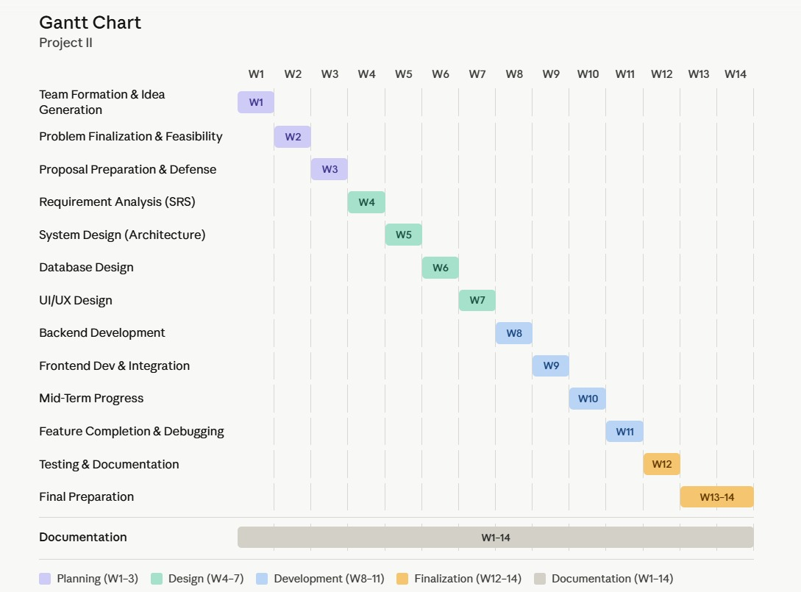
Gantt Chart

Slide 17
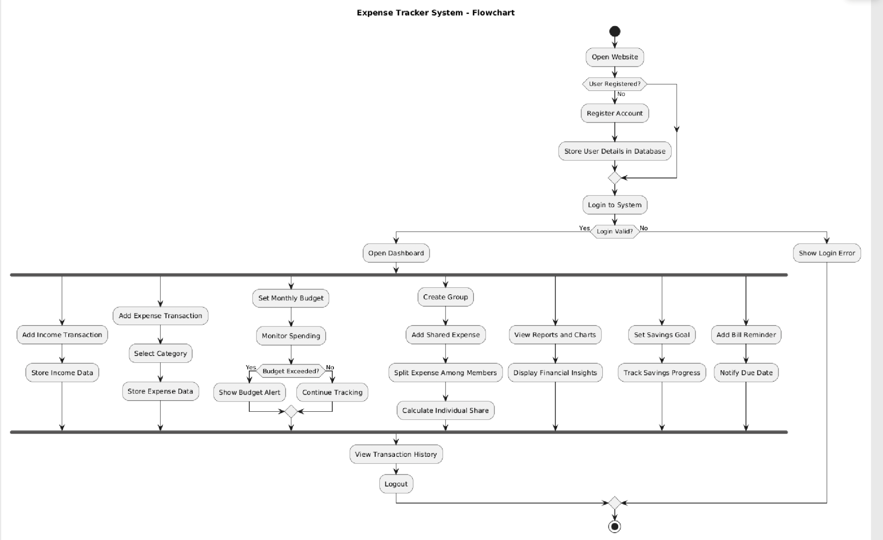
Flowchart

Slide 18
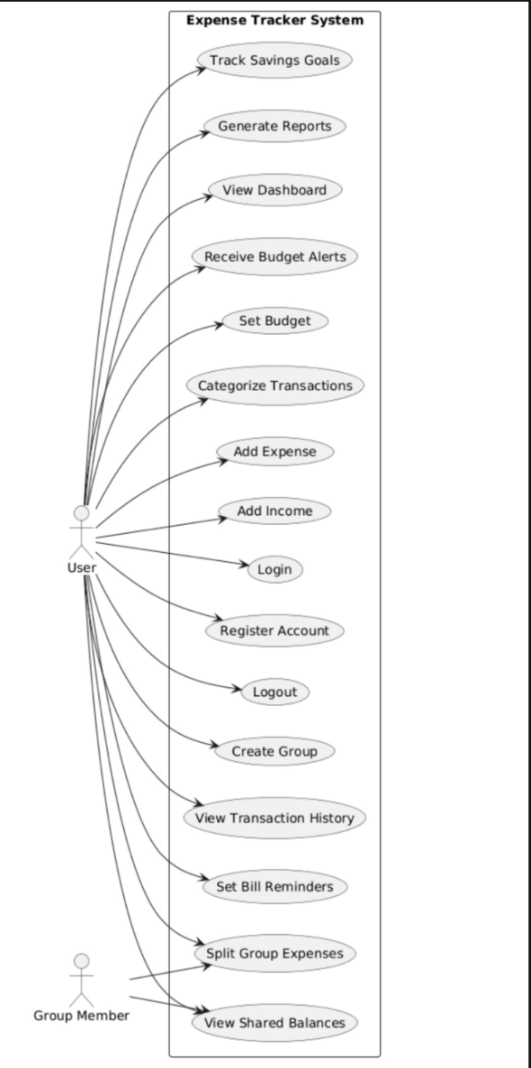
Use-Case Diagram

Slide 19
Any questions?

Slide 20
Thank you

